Slide 1
INVENTORY Case Study
CIS 355 ∙ Dr. Joseph Clark ReF: Kimball Ch. 4

Slide 2
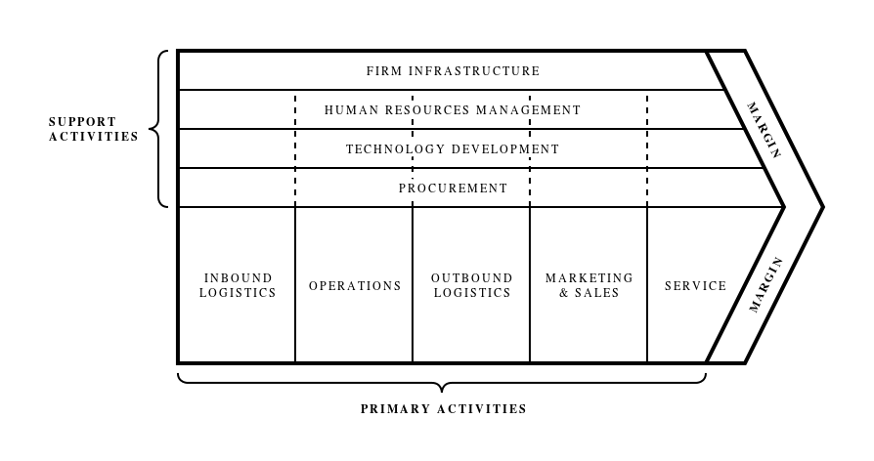
Value chains
Reminder: The dimensional modeling process introduced in chapter 3 began with “identify the business process”.
Business processes may be grouped together as part of a value chain.
May be defined as “a chain of activities that a firm operating in a specific industry performs in order to deliver a valuable product or service for the market.”
Plotting your company’s (or industry’s) value chain should give you a whole list of business processes that are important enough to analyze.
Michael Porter’s classic “value chain” diagram

Slide 3
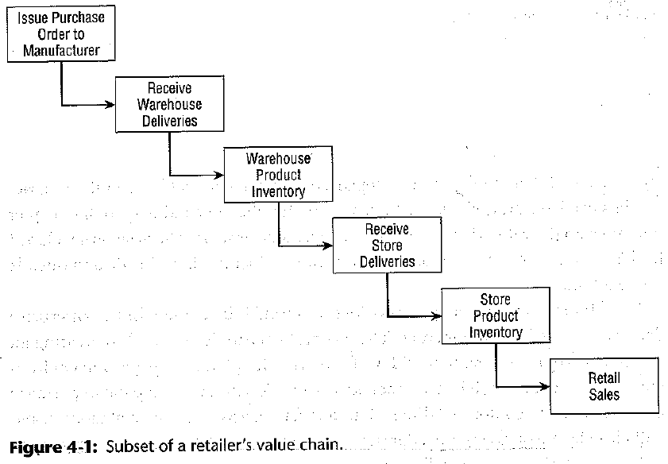
Value chain for retail sales case
A possible value chain for retail is depicted in figure 4-1.
Inventory is seen flowing from manufacturers to warehouses, then to store shelves, and leaving the system through sales to customers.
Each box in the diagram can be seen as a “business process”. Note that the final box is retail sales, the business process we modeled in chapter 3.
Therefore, several dimensional models and star schemas are possible.
We could also view the whole picture as a business process from the point of view of an article of inventory.

Slide 4
How do we want to analyze inventory?
Periodic snapshots of inventory:
Which items are in or out of stock?
How many days’ worth of inventory are we carrying?
What is our inventory worth?
Inventory transactions:
How frequently are we receiving deliveries at each warehouse?
How many shipments from supplier X failed inspection?
Inventory items moving through the system:
How long does it take for us to process deliveries?
How long do products sit in the warehouse?

Slide 5
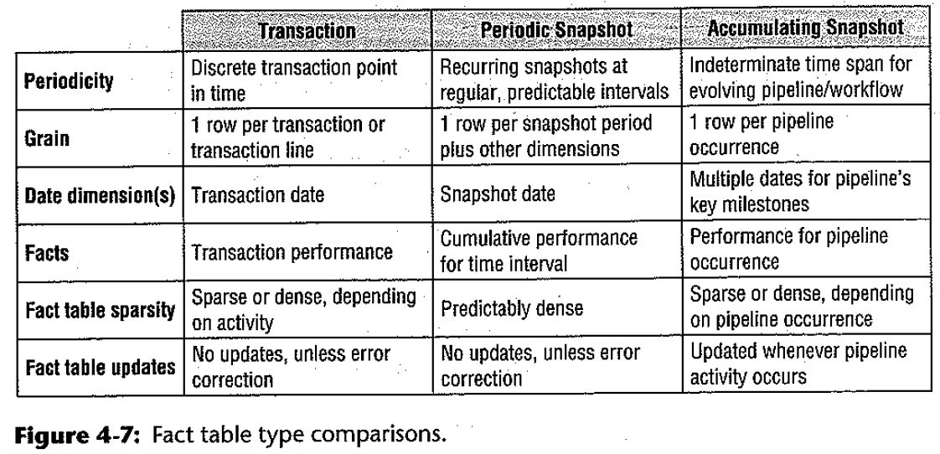
Three types of fact tables

Slide 6
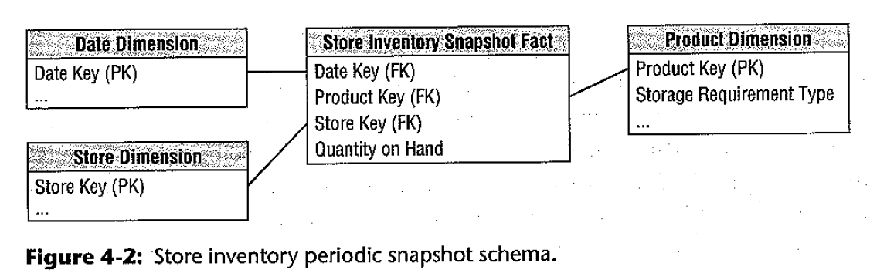
A store inventory periodic snapshot model
The business process: periodic snapshots of inventory in the stores.
You could do another dimensional model like this for the warehouses, etc.
The grain and dimensions: daily snapshot for each product, each store. Note that with a periodic snapshot model, there’s no “transaction” to guide you, so the grain is pretty much determined by the dimensions.
The main fact: quantity on hand.
Notice: we are re-using three dimension tables we already created in the last chapter. Only the fact table is new here!

Slide 7
Issues with periodic snapshot model
These are dense fact tables. Our retail sales schema last time was sparse: it contained rows for the products that were sold in a transaction, but no rows for the products that weren’t sold. By contrast, the snapshot table must contain one row per product per day even if the inventory on hand is zero.
60,000 products * 100 stores * 365 days = 2,190,000,000 new rows of data per year.
We’re dealing with semi-additive facts. Quantity on hand can be added across some dimensions (Store, and maybe Product) but not across others (Date).
If there are 50 apples at store A and 50 apples at store B, you could say there are 100 apples total.
If there are 100 apples in inventory each day this week, you cannot add them up and say there were 700 apples in inventory at the end of the week! (Instead, you might average across the date dimension.)
(If there are 100 apples and 200 oranges in inventory, you could add them and say there are 300 “units” of apples-and-oranges, but it’s up to the business whether that means anything.)

Slide 8
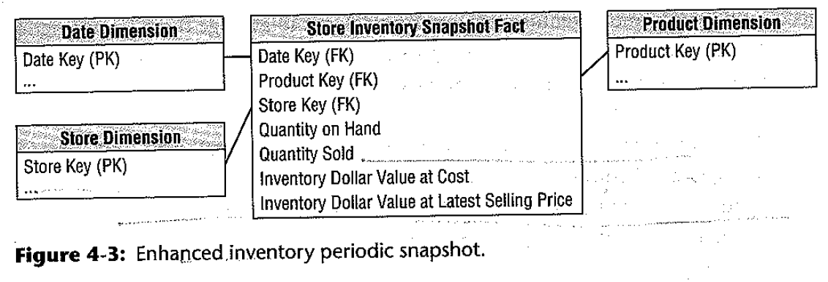
What questions could this model answer?
By adding daily sales to the fact table (or average daily sales to the Product dimension), we can examine inventory levels in relation to sales, namely:
Number of turns = (quantity sold / quantity on hand). If you sell 1000 apples per day and have 100 on hand, the inventory “turns over” ten times per day.
Days supply = if you sell 20 bottles of tequila per day, and have 100 bottles on hand, then you have a five days’ supply.
You could also try to calculate the cost of inventory for a number of purposes:
Value of inventory at current retail price.
Replacement cost of inventory at wholesale price.
Square footage of shelf space in use, or storage space required in the back room, etc.

Slide 9
Three types of fact tables

Slide 10
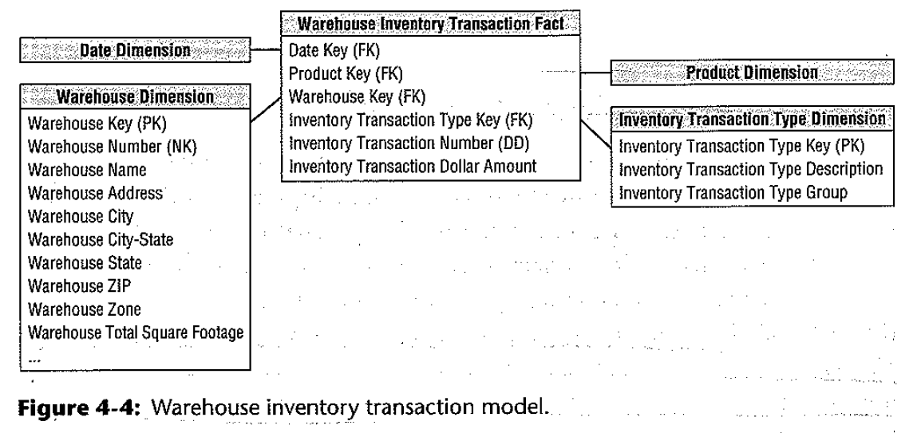
A warehouse inventory transaction model
Lots of transactions happen in the warehouse. They might include:
Receiving a product.
Place product in queue for inspection.
Return product to vendor (if it fails inspection).
Place product in bin (if it passes inspection).
Pick product from bin.
Ship product to customer.
Process returned product from customer.
The grain here is one row per transaction of any type in any warehouse.
The fact could be quantity processed, or dollar amount (as in the example), or simply the number “1” which could be added to give us a count of rows. (i.e. a factless fact table)
Here we continue to re-use the date and product dimensions, but we have to create two new dimension tables: Warehouse and Inventory Transaction Type.

Slide 11
What questions could this model answer?
We might constrain by transaction type in order to determine the level of activity in each warehouse:
Number of deliveries accepted.
Number of shipments sent out.
Number of returns processed.
We might constrain by product in order to learn:
Which products have a high ratio of returns to shipments.
Theoretically, we could derive stock levels at any point in time by adding and subtracting all the relevant transactions, making the periodic snapshot model redundant. However:
The queries would be quite complex and run on millions or billions of rows each time they were processed.
The numbers might not match anyway, because of spoilage, shoplifting, etc.

Slide 12
Three types of fact tables

Slide 13
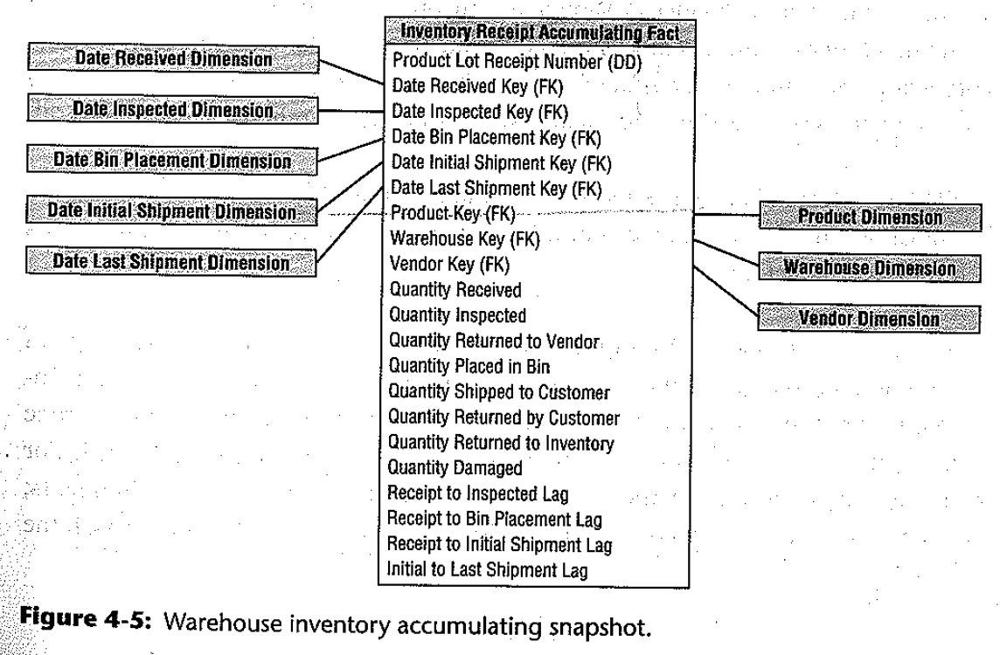
An inventory accumulating snapshot model
An accumulating snapshot tracks each item – not the product like “apples”, but this particular apple (or lot) – as it moves through a process with numerous milestones.
The technical requirement is that each operational system along the value chain must have a way to consistently identify the item.
For example, an RFID tag on the box or pallet.
These models have lots of foreign keys to the date dimension (or time dimension) and their facts relate to the various milestones in the process.
Many of the facts and dimensions will be empty (NULL) in new rows, and updated later. This contrasts with the typical “write-once” paradigm of data warehousing.

Slide 14
What questions could we answer with this?
Accumulating snapshots are very useful for supply chain management, workflow or pipeline analysis. They provide two key types of data:
How much time passed between each milestone.
How many units passed from each stage to the next.
In this case, we can analyze the quantity of items (e.g. fruit) that spoiled in the warehouse, or on the shelves, or were lost in transit, by comparing the number received from the vendor to the number finally sold to customers.
Think back to the “funnel” analysis discussed in the Guthy-Renker case study. How useful would it be to have an accumulating snapshot for every prospective customer?

Slide 15
Three types of fact tables

Slide 16
A few key points on fact table types
“Transactions and snapshots are the yin and yang of dimensional designs.” (p.122) Having both of them allows you to have a well-rounded view of business processes, and drill down to the deepest details.
Although you could derive snapshot tables from transactional data (so they are slightly redundant), we don’t care about that because, remember, the motivations for dimensional data modeling are:
Deliver data that’s understandable to the business users.
Deliver fast query performance.
We’re willing to trade disk space and up-front work for these goals.
Accumulating snapshots are kind of an odd duck in dimensional models, because they have special technical requirements: tracking items through multiple source systems, and regular updating of the data.
Dimensions can and should be re-used across models!

Slide 17
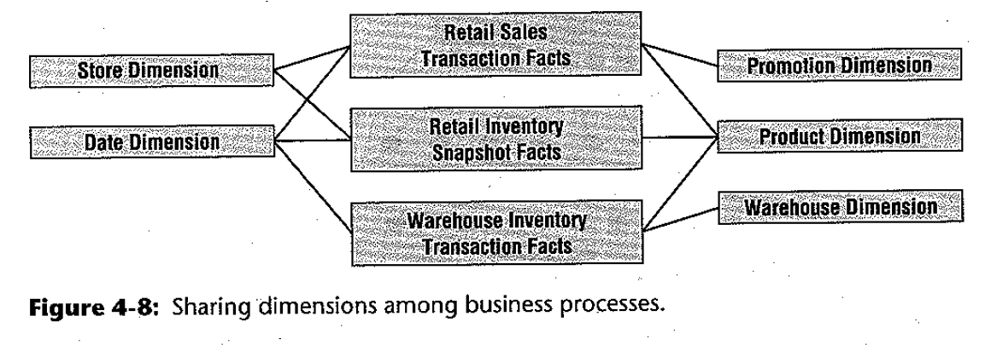
Integration of dimension data
Re-using dimensions among dimensional models is not only a convenient time-saver, it is absolutely essential for integrating the data so that, as you build more and more models, they can be used together for complex analyses.

Slide 18
The Kimball-inmon debate
In chapter 1, around pp. 27-30, Kimball alluded to his long-running debate with Bill Inmon’s camp on the issue of data warehouse architecture. Let’s re-visit that debate.
Inmon
Kimball
Inmon advocates for a “Corporate Information Factory” model in which source systems are used to create an Enterprise Data Warehouse (EDW) holding all the important data from the business in a normalized, consistent structure.
Dimensional models (or “data marts”) are derived from the EDW.
This guarantees consistency in dimensional data and fact data, because it was all cleaned up and reconciled in the process of creating the EDW.
Dimensional models (or “data marts”) are derived directly from source systems, with no EDW.
Thus, the “data warehouse” is just the sum total of all the data marts, whether on the same server or not.
Kimball argues that this is more realistic than the Corporate Information Factory because you can build it one star schema at a time, and deliver value to the business early.
But… how would you keep the data consistent?

Slide 19
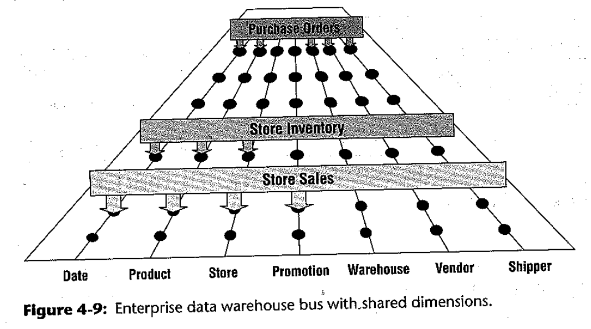
The enterprise data warehouse bus architecture
“Obviously, building the enterprises DW/BI system in one galactic effort is too daunting, yet building it as isolate dpieces defeates the overriding goal of consistency. For long-term DW/BI success, you need to use an architected, incremental approach to build the enterprise’s warehouse. The approach we advocate is the enterprise data warehouse bus architecture.” (p.123)
The bus architecture in a nutshell: dimensions must be built with care, once, so they can be re-used in future models. Soon you have a whole repertoire of dimensions that new models can “plug in” to, instead of replicating the work inconsistently.
Conformed dimensions are built once in the ETL system and then replicated logically or physically throughout the enterprise DW/BI environment. (p.130)
Note:
You don’t have to agree with Kimball on this to pass the class. The Inmon view is also very popular.

Slide 20
Purported benefits of the bus architecture
“The bus architecture enables DW/BI maangers to get the best of both worlds.”
“They have an architectural framework guiding the overall design, …”
“but the problem has been divided into bite-sized business process chunks that can be implemented in realistic time frames.”
Additional benefits:
Separate teams can work on separate parts of the project, and integrate their work later.
After the first few dimensional models are created, new ones can be created faster and cheaper by re-using dimensions.

Slide 21
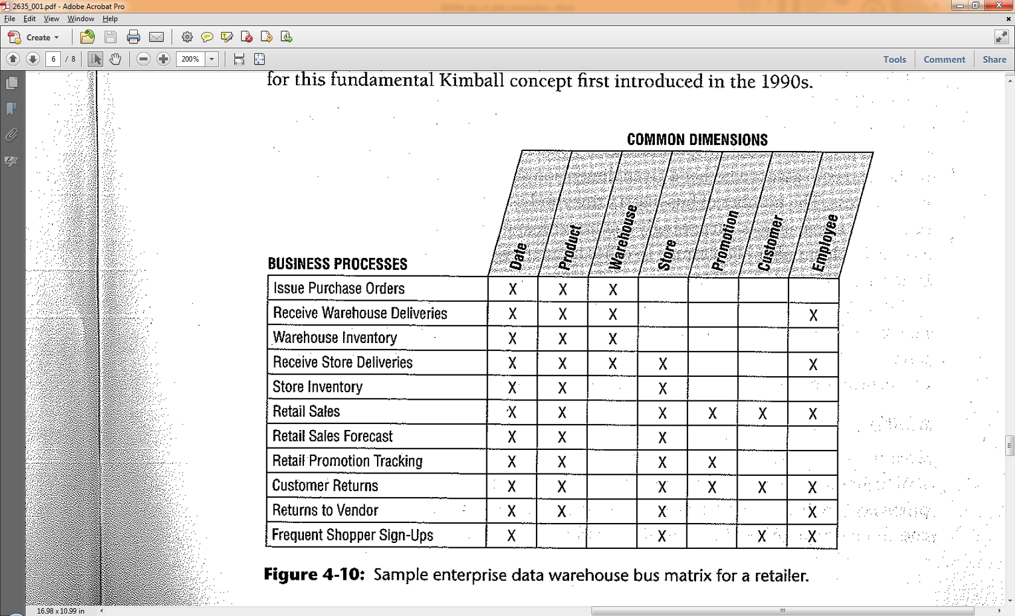
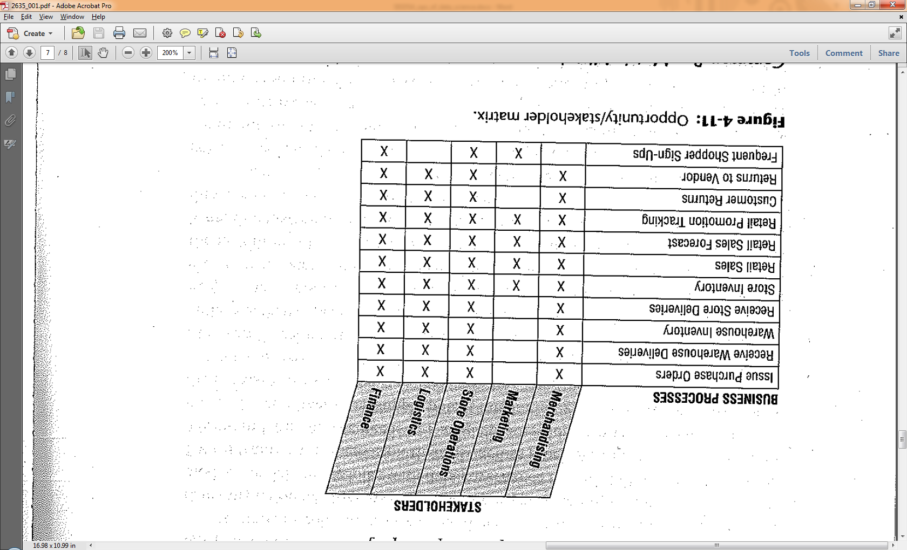
Bus matrix and opportunity/stakeholder matrix
The enterprise data warehouse bus matrix is a way to document the bus architecture and identify projects. Which are the “low hanging fruit” that re-use a lot of the work you’ve already done?
The opportunity-stakeholder matrix is a clue to who should be invited to each discussion.
You’re required to do one of these for the second “requirements” assignment due 10/27.

Slide 22
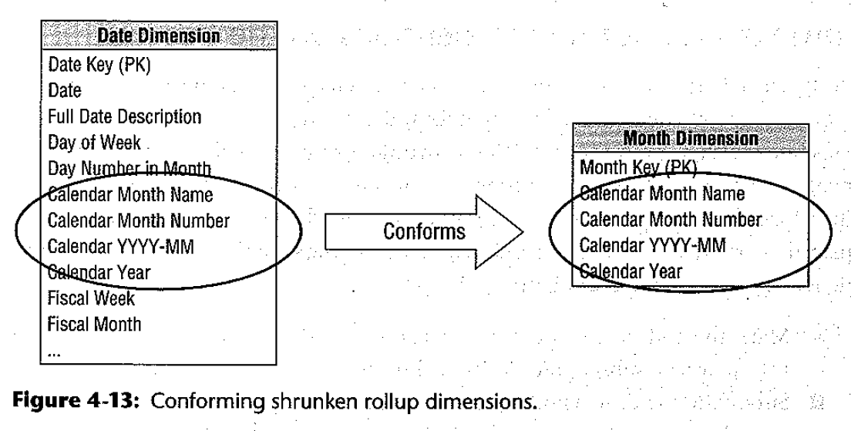
Notes on conformed dimensions
Conformed dimensions “mean the same thing with every possible fact table to which they are joined” (p.131).
This doesn’t mean they’re necessarily identical.
A dimension (e.g. “Product”) could have some extra attributes in the retail sales model that aren’t relevant in the inventory model, or vice versa. All that’s necessary is that the attributes which are common to all models mean the same thing.
A model may use a subset of one dimension. For example, a monthly periodic snapshot model might use a Month dimension which is just a subset of the Date dimension used in other models. These still conform.
Conformed dimensions require data governance and stewardship. Different stakeholders need to agree on, and somebody needs to be responsible for, data definitions and data quality.

Slide 23
agility
Agility is a key paradigm in information systems development. It is a major theme in software development and is working its way into database disciplines, too.
Key features of Agile methods are:
Frequent iteration and constant feedback from users, customers, testers, etc.
Cross-functional teams so you have fully-working products at an early stage.
Small investments so that mistakes are corrected quickly.
The next two slides compare “incremental” project management (not Agile) to “iterative” approaches (Agile).

Slide 24
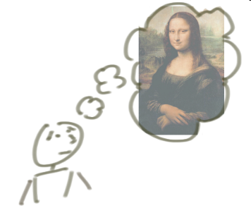

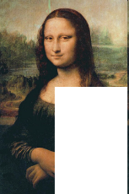

Incrementing vs. Iterating
“Incremental” means building something a bit at a time.
Incrementing calls for a fully formed idea
1
2
3
Notes:
Source of slide: http://agileproductdesign.com/downloads/patton_iterating_and_incrementing.ppt

Slide 25
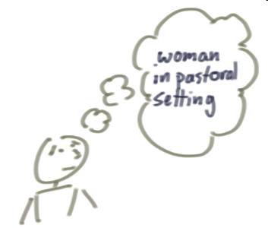
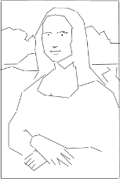


Incrementing vs. Iterating
By contrast, “Iterative” starts with a rough vision, validates it through feedback from the customer, improves it through learning, and continues to add more value.
Iterating allows you to move from vague idea to realization
1
2
3
Notes:
Source of slide: http://agileproductdesign.com/downloads/patton_iterating_and_incrementing.ppt

Slide 26
The Kimball approach and agility
Kimball’s big claim is that his enterprise data warehouse bus architecture enables Agility in DW/BI development, more than the Inmon (corporate info. factory) approach. Why?
You get a complete, working data mart into the hands of the business early. (No waiting to complete an EDW.)
The business can see the value of your work, or ask you for changes, before you’ve spent a lot of time and money.
If it’s seen as valuable, they can request another dimensional model, and another, and another, and get the value of each one as soon as it’s ready.
Conformed dimensions enable you to efficiently and effectively build on what you’ve already created.
By contrast, the Inmon model seems to require a “waterfall” approach in which the customer doesn’t see the product until the entire project is finished (and the budget all spent).

Slide 27
Next week
Before Monday’s class time, I’ll prepare a video lecture for midterm exam review, and upload it to Blackboard. You will also be able to download my slides and/or notes from GitHub at that time.
Your first “project requirements” milestone is due Monday night. Try to do it before you prep for the midterm; I think that may be helpful.
The exam will be at the normal time, in the normal room, next Wednesday. I will arrange someone to proctor it.

